Slide 1
Managing Linux File System and File Security
MODULE 6
Managing Linux File System and File Security
Linux File Management
Linux File System Description
Common File System Tasks
Viewing Text File Contents
Using Removable Media
Mounting and Unmounting Storage Devices
Creating new file systems
Testing and repairing file systems
Searching within the File System
File Security
Password-based Protection
Encryption-based Protection
Protection-based on Permission
Types of Users
Types of File Operations/Access Permission

Slide 2
Linux File Management
While using a computer system, a user is constantly performing file-related operations: creating, reading,writing/modifying, or executing files. Therefore, the user needs to understand
what a file is in Linux,
how files can be organized and managed,
how they are represented inside the operating system, and
how they are stored on the disk.
In this course a simple presentation on file description and storage is made.
In Linux, a file is a sequence of bytes. Thus, everything, including a network interface card, a disk drive, a Universal Serial Bus (USB) flash drive, a keyboard, a printer, a simple/ordinary (text, executable, etc.) file, or a directory, is treated as a file.

Slide 3
Linux File System Description
ext2, ext3 and reiser file systems discussed in previous slide are more properly termed disk file systems.
disk file systems are used to define how data is stored on your Linux system’s hard disk drive.
A disk file system is a specific implementation of a file system in general.
There are other implementations of file systems in addition to disk file systems, including: database file systems and network file systems, such as the Network File System (NFS) or the Server Message Block (SMB) file system.

Slide 4
The Role of the Linux File System
So what exactly is the role of the file system in general on a Linux system (or any other operating system, for that matter)? We’re talking about a system that stores information on a storage device in such a manner that:
The data is organized and can be easily located.
The data can be easily retrieved at any later point in time.
The integrity of the data is preserved.
In other words, if you save a file to a storage device, you should be able to find it later on and retrieve it, assured that its contents will be exactly the same as when it was saved

Slide 5
Types of Files
Linux supports seven types of files:
• Simple/ordinary file
• Directory
• Symbolic (soft) link
• Character special file
• Block special file
• Named pipe (also called FIFO)
• Socket
You can use the ls –l command to display the type of a file.
Simple/ordinary files are used to store information and data on a secondary storage device, typically a disk.

Slide 6
An ordinary file may contain any of the following:
• Unstructured text
• Source code (or script) in a programming language such as C, C++, Java, Ruby, Python, LISP,and Bash
• An executable program that you have created by compiling (and linking) a source program
• Applications such as compilers, database tools, desktop publishing tools, and graphing software
• PostScript code
• Pictures
• Video
• Audio
• Graphics
• Etc.

Slide 7
The Hierarchical Structure of the Linux File System
The file system used by Linux uses a hierarchical structure to organize and store data. That is treelike, but upside down, with the root at the top.
The topmost directory in the structure is the / directory, also called the root directory.
This has nothing to do with your root user account. It simply specifies that this directory is the root of your hierarchical file system tree.
Beneath the root directory are a series of subdirectories.
Specifications for how these directories are to be named are contained in the File system Hierarchy Standard (FHS)
The FHS provides Linux software developers and system administrators with a standard directory structure for the file system, ensuring consistency between systems and distributions.

Slide 8
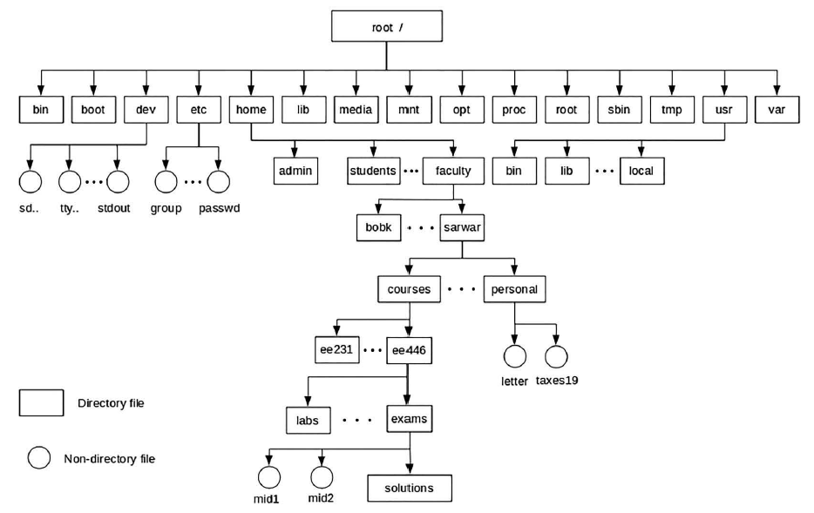
A file or directory in a hierarchical file system is specified by a pathname. Simply put, a pathname is the full name of a file. Most Linux systems place all home directories under /home. The following figure shows diagramatic description of the structure

Slide 9
The Hierarchical Structure of the Linux File System
The FHS defines the directories that should appear under the root directory (/) as well as the directories that should appear under the /usr and /var directories. These include the following:
/bin This directory contains executable files necessary to manage and run the Linux system, including shells (such as bash) and file system management utilities such as cp and rm.
/boot This directory contains your bootloader files, which are required to boot your system.
/dev This directory contains special files that are used to represent the various hardware devices installed in the system. Remember when we installed Linux? We said that the first SCSI hard disk drive in your system was called sda and the first IDE hard drive in your system was called hda. The files that represent these devices are stored in /dev, Other hardware devices are also represented by files in /dev
/etc This directory contains text-based configuration files used by the system as well as services running on the system. You can edit these files with a text editor to customize how Linux behaves.
/home This directory contains subdirectories that serve as home directories for each user account on your Linux system.

Slide 10
/lib This directory contains code libraries used by programs in /bin and /sbin. Your kernel modules are also stored in the modules subdirectory of /lib.
/media This directory is used by some Linux distributions (such as SUSE Linux) to mount external devices, including CD drives, DVD drives, and floppy drives. This is done using a series of subdirectories.
/mnt This directory is used by some Linux distributions (such as Fedora or Red Hat) to mount external devices, including CD drives, DVD drives, and floppy drives. As with the /media directory on a SUSE system, a series of subdirectories are used to do this.
/opt This directory contains files for some programs you install on the system.
/proc This directory is a little different from the other directories in this list. /proc doesn’t actually exist in the file system. Instead, it’s a pseudo file system that is dynamically created whenever it is accessed. It’s used to access process information from the Linux kernel.

Slide 11
Common File System tasks: Navigating the File System
As you work with the Linux file system, one of the most common tasks you will need to complete is to move around between the different directories on your hard disks.
Your Linux system provides the following commands that you can use from the shell prompt to do this:
■ pwd :The pwd command is a relatively simple utility. It simply displays the current directory on the screen. (pwd stands for Present Working Directory.)
This utility can be exceptionally useful if your shell profile hasn’t been configured to display the current directory as a part of the shell prompt.
To use pwd, simply enter pwd at the shell prompt. The ~ character in the shell prompt is shorthand that refers to the current user’s home directory.
At this point, you know how to identify what directory you’re in. More than likely, you’re going to need to change to a different directory in the file system at some point. Let’s discuss how to do this next

Slide 12
Using the cd Command
■ cd
You can also use absolute paths with the cd command. When you use an absolute path, you specify the full path, starting from /, to the directory you want to change to.
For example while in /home/Babcock one can issue the cd /var/log command. Because we specified an absolute path, the cd command knew that the var/log directory didn’t exist in the current directory. Instead, the path was determined from the root directory (/) and the current directory was changed to it.
If you enter cd at the shell prompt without specifying a path, it will automatically change directories to the home directory of the currently logged-in user.
You can also use the cd command to move up the file system hierarchy. You can do this by entering cd .. . This will change the current directory to the next directory higher in the hierarchy. For example if working at /var/log and the cd .. command is issued, it changes the directory from /var/log to /var.

Slide 13
Using the ls Command
■ ls
The ls command is used to list the files and subdirectories that may exist within a directory.
If you enter ls at the shell prompt, the contents of the current directory are listed on the screen.
As with the cd command, you can also provide an absolute path when using ls. This will cause ls to display the contents of the directory you specify.
When working with ls, you can use a variety of options to customize how it works. Some of these options include the following:
–a Displays all files, including hidden files.
–l Displays a long listing of the directory contents. This is a very useful option. You can use it to see the file names, ownership, permissions, modification date, and size.

Slide 14
Creating Files and Directories
From time to time, you will need to create new files and directories in your Linux file system.
Creating a new file can be accomplished using the touch command from the shell prompt.
To use touch, enter touch followed by the name of the file you want to create
You can also use shell commands to create new directories.
This is done using the mkdir command.
As with touch, you can enter mkdir from the shell prompt followed by the name of the directory you want to create.
Example: $ mkdir mydocs
Create a file inside mydocs: $mydocs touch myfile

Slide 15
Viewing Text File Contents
cat The cat filename command will display the specified text file on screen. This command doesn’t pause the output, so if you use it to view a long file, you may need to append |more to the command to pause the output a page a time.
less The less filename command can also be used to display the specified text file on screen, much like cat. However, the less command automatically pauses a long text file one page at time. You can use the SPACEBAR, PAGEUP, PAGE DOWN, and ARROW keys to navigate around in the file.
head The head filename command is used to display the first couple of lines of a text file on the screen.
tail The tail filename command is used to display the last couple of lines of a text file on screen. The tail command is particularly useful when displaying a log file on screen. When viewing a log file, you probably only want to see the end of the file. You probably don’t care about log entries made several days ago. You can use tail to see just the last log entries added to the end of the file.

Slide 16
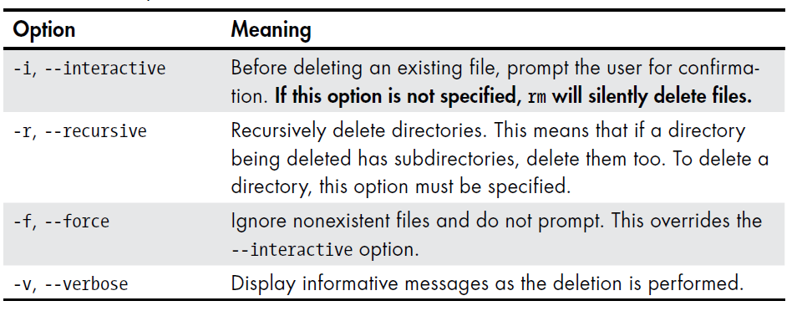
Deleting Files and Directories
■ rmdir This utility can be used to delete an existing directory. To use it, simply enter rmdir directory_name
For example, rmdir MyFiles. Be aware, however, that rmdir requires that the directory be empty before it will delete it.
■ rm The rm utility is a more powerful deletion utility that can be used to delete either a file or a populated directory.
To delete a file,
simply enter rm filename.
To delete a directory,
enter rm –r directory_name.

Slide 17
Deleting Files and Directories[ctd]

Slide 18
Copy Files and Directories
The cp command copies files or directories. It can be used two different
ways. The following:
cp item1 item2: copies the single file or directory item1 to the file or directory item2. Whereas
This command:
cp item... Directory: copies multiple items (either files or directories) into a directory

Slide 19
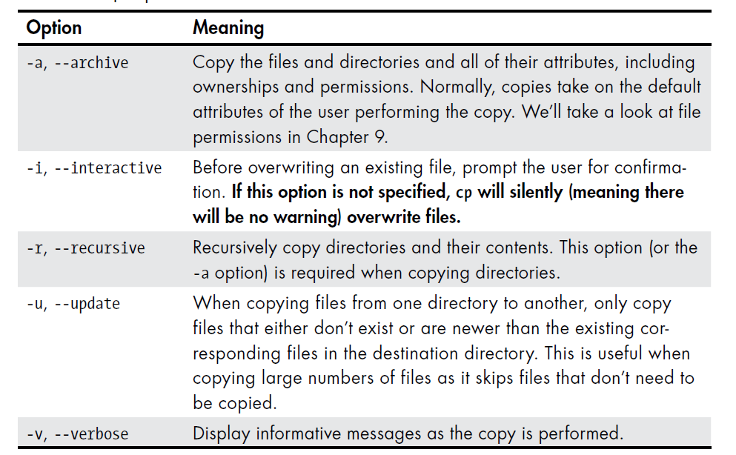
Useful Options and Examples

Slide 20
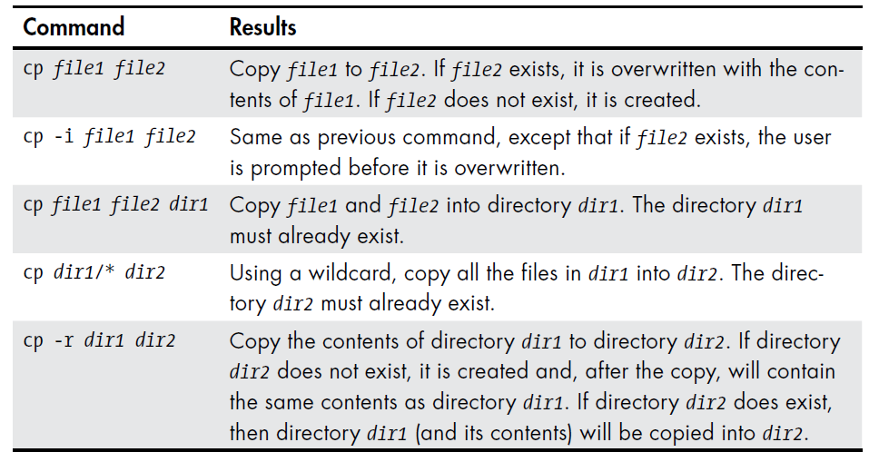
cp: Examples

Slide 21
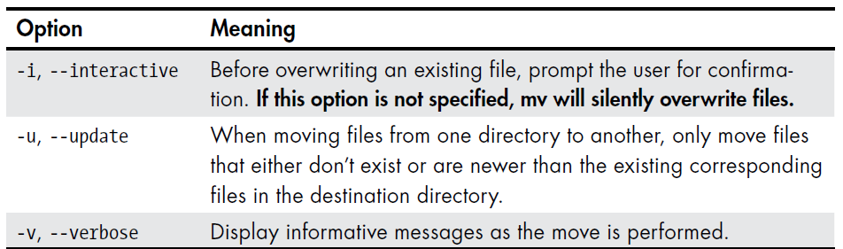
mv—Move and Rename Files
The mv command performs both file moving and file renaming, depending on how it is used. In either case, the original filename no longer exists after the operation.
mv is used in much the same way as cp, as shown here:
mv item1 item2: to move or rename the file or directory item1 to item2. It’s also used as follows
mv item... directory: mv shares many of the same options as cp, as described above
Useful Options and Examples

Slide 23
File Security
File Security
Password-based Protection
Encryption-based Protection
Protection-based on Permission
Types of Users
Types of File Operations/Access Permission

Slide 24
Objectives
To show the protection and security mechanisms that Linux provides
• To describe the types of users of a Linux file
• To discuss the basic operations that can be performed on a Linux file
• To explain the concept of file access permissions/privileges in Linux
• To discuss how a user can determine access privileges for a file
• To describe how a user can set and change permissions for a file
• To discuss special protection bits, set-user-ID, set-group-ID, and sticky bit, and describe their purpose
• To cover the following commands and primitives:

Slide 25
Introduction
In a time-sharing system like Linux there are great benefits. However, there is a main challenge of protecting the hardware and software resources in it. These resources include the input/ output devices, central processing unit (CPU), main memory, and the secondary storage devices that store user files.
To protect user files from unauthorized access is to
Give every user a login name and a password(the most fundamental scheme) allowing a user to use a system
Protects individual files by converting them to a form that is completely different from the original version by means of encryption. This technique is used to protect your most important files, so that the contents of these files cannot be understood even if someone somehow gains access to them on the system
allows you to protect your files by associating access privileges with them, so that only a subset of users can access these files for a subset of file operations

Slide 26
Password-Based Protection
The first mechanism that allows you to protect your files from other users is the login password scheme. Every user of a Linux-based computer system is assigned a login name (a name by which the user is known to the Linux system) and a password. The following methods of discovering a user’s password:
1.You, as the owner of an account, inform others of your password.
2. A user guesses (or cracks) another user’s password using several techniques such as the dictionary, brute force, rainbow table, and spidering attacks.
3. Using phishing to obtain your password.
4. Using social engineering to obtain your password.
5. Using malware or keylogger to obtain your password

Slide 27
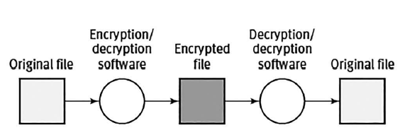
Encryption-Based Protection
In this scheme, a software tool is used to convert a file to a form that is completely different from its original version. The transformed file is called an encrypted file, and the process of converting a file to an encrypted file is called encryption.
The Linux commands mcrypt and openssl can be used to encrypt and decrypt your files. You can learn more about these commands by running the man mcrypt and man openssl commands

